Slide 1
Solving problems by searching

Slide 2
Outline
Problem-solving agents
Problem types
Problem formulation
Example problems
Basic search algorithms
*
2

Slide 3
Goal based agents
Reflex agents base cannot operate well where this mapping would be too large to store and would take too long to learn.
Goal-based agents, on the other hand, can succeed by considering future actions and the desirability of their outcomes.
Problem-solving agents decide what to do by finding sequences of actions that lead to desirable states.
*
3

Slide 4
Uninformed Vs informed
The algorithms are uninformed, in the sense that they are given no information about the problem other than its definition.
Informed search algorithms are the ones that have some idea of where to look for solutions.
*
4

Slide 5
Problem characteristics (Ref- Rich & knight)
Is the problem decomposable ?
Can solution steps be undone?
Single solution or set of solutions?
Any solution or best solution?
Is solution a path or a state?
Is the universe predictable?
Role of knowledge?
Does the task requires interaction with the person
*
5

Slide 6
Problem characteristics (Ref- Rich & knight)
Is the problem decomposable ?
Strategies- Divide and conquer, greedy, dynamic
Example problems- integration by parts, merge/quick sorts, binary search, knapsack, n queens, shortest paths etc)
Can solution steps be undone?
Strategies-backtracking, branch and bound
Example problems- 8 puzzle, n queen, knapsack, graph coloring, TSP
*
6

Slide 7
Single solution or set of solutions?
Single solution- suitable strategy, min cost spanning tree
Set of solutions – n-queens, TSP etc
Any solution or best solution?
Best solution- optimization strategies
Is solution a path or a state?
Path – informed, uninformed, planning, adversarial search; 8-puzzle, water jug, TSP
State – local search algos, constraint satisfaction; knapsack, graph coloring, n queens, cryptarithmetic problems
*
Swati Mali
7

Slide 8
Is the universe predictable?
Predictable – problems those don’t involve uncertainty; solved with general algo strategies
unpredictable – problems with uncertainty; solved with Bayesian network, soft computing techniques
Role of knowledge?
AI and knowledge based problems
Does the task requires interaction with the person
*
Swati Mali
8

Slide 9
Problem solving agents
Goal formulation : is based on the current situation and the agent's performance measure. (Goals help organize behavior by limiting the objectives that should be achieved)
Problem formulation: is the process of deciding what actions and states to consider, given a goal
Search
Execute
Formulate-Search-Execute
*
Swati Mali
9

Slide 10
Desired environments
Static: because formulating and solving the
problem is done without paying attention to any changes that might be occurring in the environment.
*
10

Slide 11
Assumes that the initial state is known; knowing it is easiest if the environment is observable
The idea of enumerating "alternative courses of action“ assumes that the environment can be viewed as discrete.
Finally, and most importantly, the agent design assumes that the environment is deterministic
*
11

Slide 12
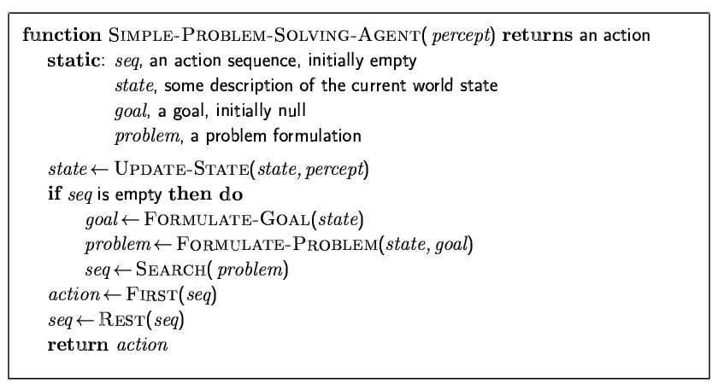
Problem-solving agents
*
12

Slide 13
Problem Formulation
State description
Initial state
Successor function
State space
Goal test
Path cost
*
13

Slide 14
Water jug problem
Initial state w_j(0,0)
Actions- fill_in, transfer, empty
Successor function
<fill_in(3), w_j(3,0))
<fill_in(5), w_j(0,5))
*
14

Slide 15
Kitchen cleaning problem
Initial state kitchen(floor1,fridge1,stove0,sink0,platform0)
Successor functions
<clean(fridge), kitchen(floor1,fridge0,stove0,sink0,platform1)>
*
15

Slide 16
Problem Formulation
Abstraction
Types
Incremental
complete
*
16

Slide 17
Example: Romania
*
Swati Mali
17

Slide 18

Example: Romania
*
Swati Mali
18

Slide 19
Problem types
If Deterministic, fully observable 🡪 single-state problem
Agent knows exactly which state it will be in; solution is a sequence
If Non-observable 🡪 sensorless problem (conformant problem)
Agent may have no idea where it is; solution is a sequence
If Nondeterministic and/or partially observable 🡪 contingency problem
percepts provide new information about current state
often interleave search, execution
If Unknown state space 🡪 exploration problem
*
19

Slide 20
Single-state problem formulation
A problem is defined by four items:
initial state e.g., "at Arad“ actions or successor function S(x) = set of action–state pairs
e.g., S(Arad) = {<goto(Zerind), in(Zerind)>, … }
goal test, can be
explicit, e.g., x = in(Bucharest)
implicit, e.g., Checkmate(x)
path cost (additive)
e.g., sum of distances, number of actions executed, etc.
c(x,a,y) is the step cost, assumed to be ≥ 0
A solution is a sequence of actions leading from the initial state to a goal state
*
20

Slide 21
Selecting a state space
Real world is absurdly complex
🡪 state space must be abstracted for problem solving
(Abstract) state = set of real states (Abstract) action = complex combination of real actions
e.g., "Arad 🡪 Zerind" represents a complex set of possible routes, detours, rest stops, etc.
For guaranteed realizability, any real state "in Arad“ must get to some real state "in Zerind“ (Abstract) solution =
set of real paths that are solutions in the real world
Each abstract action should be "easier" than the original problem
*
21

Slide 22
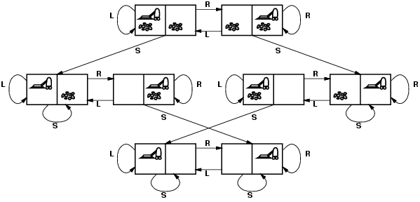
Vacuum world state space graph
states?
actions?
goal test?
path cost?
*
22

Slide 23
Vacuum world state space graph
states? integer dirt and robot location
actions? Left, Right, Suck
goal test? no dirt at all locations
path cost? 1 per action
*
23

Slide 24

Example: The 8-puzzle
states?
actions?
goal test?
path cost?
*
24

Slide 25
Example: The 8-puzzle
states? locations of tiles Puzzle(7,2,4,5,$,6,8,3,1)
actions? move blank tile left, right, up, down
goal test? = goal state (given)
Puzzle($,1,2,3,4,5,6,7,8)
path cost? 1 per move
[Note: optimal solution of n-Puzzle family is NP-hard]
*
25

Slide 26
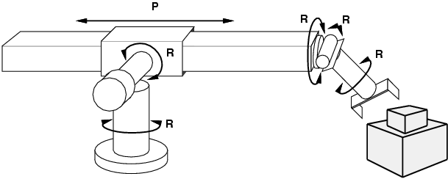
Example: robotic assembly
states?: real-valued coordinates of robot joint angles, parts of the object to be assembled actions?: continuous motions of robot joints goal test?: complete assembly path cost?: time to execute
*
26

Slide 27
Example : N Queens Problem
States: Any arrangement of 0 to 8 queens on the board is a state.
Initial state: No queens on the board
64*63* . . *57 = 1.8 x 10¹⁴.
Successor function: Add a queen to any empty square. <addQueen(I,j), atQueen(I,j)>
Goal test: 8 queens are on the board, none attacked
*
27

Slide 28
Water Jug problem
Rules to create state-space tree
*
28

Slide 29
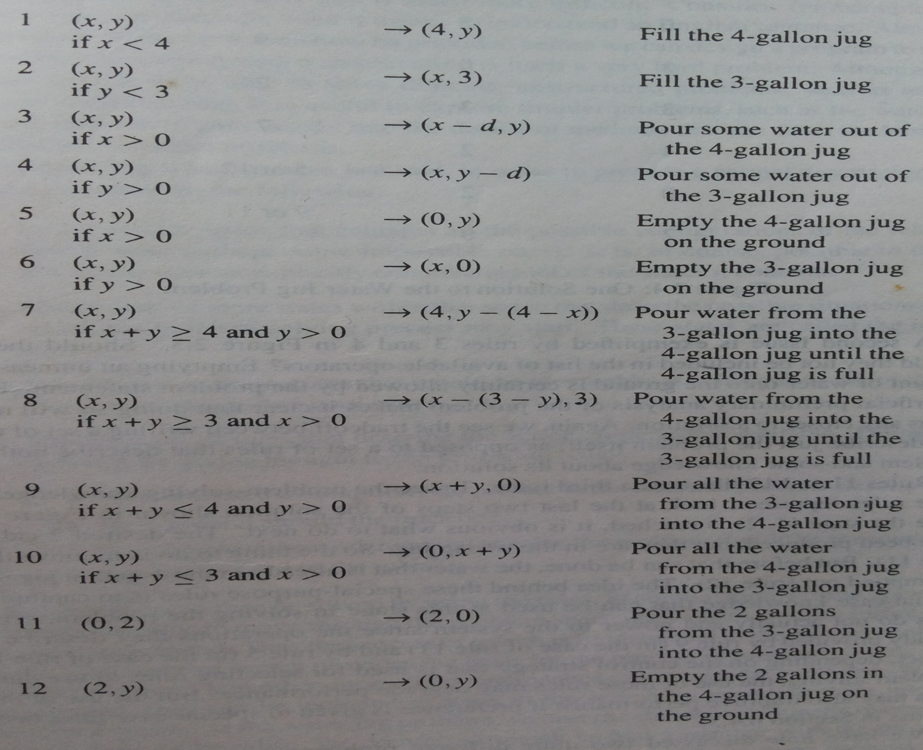
*
Swati Mali
29

Slide 30
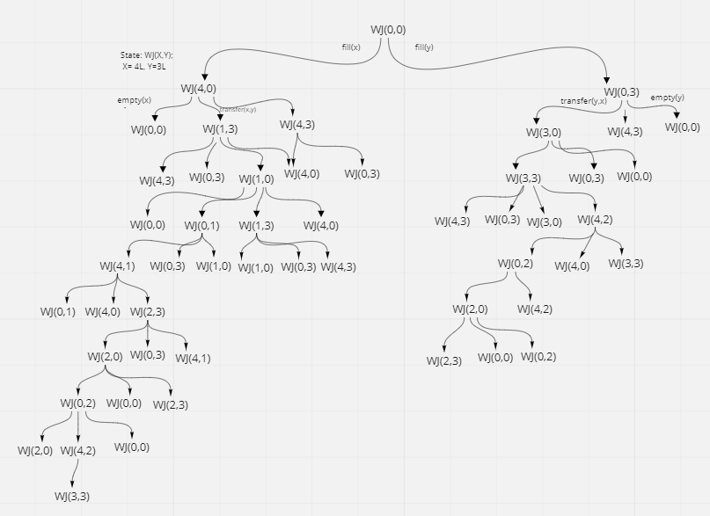
*
Swati Mali
30

Slide 31
Real World Problems
Route Finding problem
Touring problem
Travelling salesman problem
VLSI Layout
Robot Navigation
Internet searching
*
31

Slide 32
Airline Travel problem
States: Each is represented by a location (e.g., an airport) and the current time.
Initial state: This is specified by the problem.
Successor function: <Takeflight(X to Z, AtTime(Y)), In(Z)>
Goal test: destination by prespecified time
Path cost: This depends on monetary cost, waiting time, flight time, customs and immigration procedures, seat quality, time of day, type of airplane, frequent-flyer mileage awards, and so on.
*
32

Slide 33
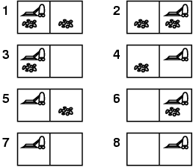
Example: vacuum world
Single-state, start in #5. Solution?
*
33

Slide 34
Example: vacuum world
Single-state, start in #5. Solution? [Right, Suck]
Sensorless, start in {1,2,3,4,5,6,7,8} e.g., Right goes to {2,4,6,8} Solution?
*
34

Slide 35
Example: vacuum world
Sensorless, start in {1,2,3,4,5,6,7,8} e.g., Right goes to {2,4,6,8} Solution? [Right,Suck,Left,Suck] Contingency
Nondeterministic: Suck may dirty a clean carpet
Partially observable: location, dirt at current location.
Percept: [L, Clean], i.e., start in #5 or #7 Solution?
*
35

Slide 36
Example: vacuum world
Sensorless, start in {1,2,3,4,5,6,7,8} e.g., Right goes to {2,4,6,8} Solution? [Right,Suck,Left,Suck] Contingency
Nondeterministic: Suck may dirty a clean carpet
Partially observable: location, dirt at current location.
Percept: [L, Clean], i.e., start in #5 or #7 Solution? [Right, if dirt then Suck]
*
36

Slide 37
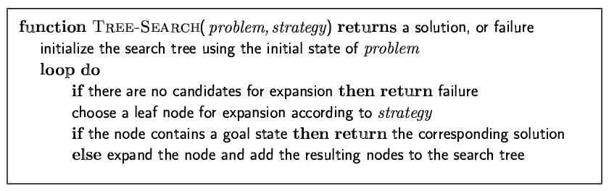
Tree search algorithms
Basic idea:
offline, simulated exploration of state space by generating successors of already-explored states (a.k.a.~expanding states)
Choice of which node to expand is determined by strategy
*
37

Slide 38
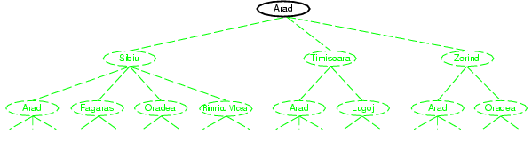
Tree search example
*
Swati Mali
38

Slide 39
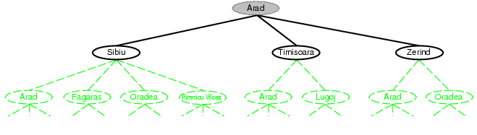
Tree search example
*
Swati Mali
39

Slide 40
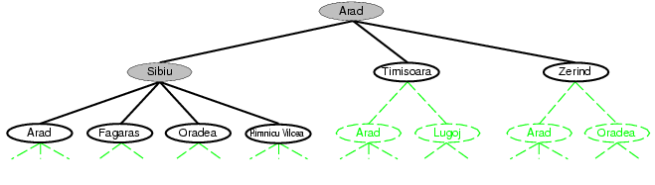
Tree search example
*
Swati Mali
40

Slide 41
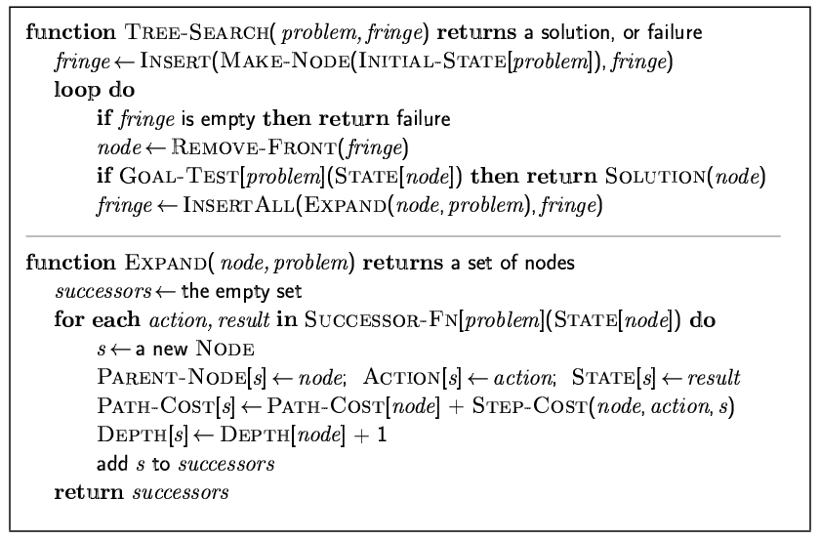
Implementation: general tree search
*
Swati Mali
41

Slide 42
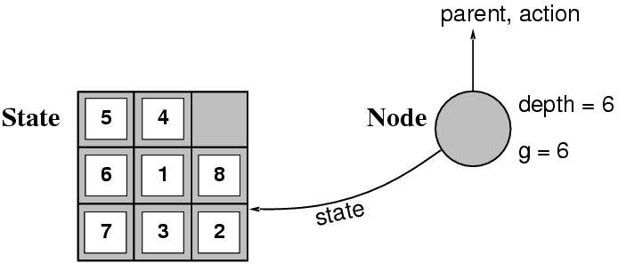
Implementation: states vs. nodes
A state is a (representation of) a physical configuration
A node is a data structure constituting part of a search tree includes state, parent node, action, path cost g(x), depth
The Expand function creates new nodes, filling in the various fields and using the SuccessorFn of the problem to create the corresponding states.
*
42

Slide 43
Search strategies
A search strategy is defined by picking the order of node expansion
Strategies are evaluated along the following dimensions:
completeness: does it always find a solution if one exists?
time complexity: number of nodes generated
space complexity: maximum number of nodes in memory
optimality: does it always find a least-cost solution?
Time and space complexity are measured in terms of
b: maximum branching factor of the search tree
d: depth of the least-cost solution
m: maximum depth of the state space (may be ∞)
*
43

Slide 44
Uninformed search strategies
Use only the information available in the problem definition
Breadth-first search Uniform-cost search Depth-first search Depth-limited search Iterative deepening search
*
44

Slide 45
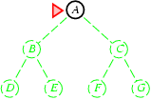
Breadth-first search
Expand shallowest unexpanded node Implementation:
fringe is a FIFO queue, i.e., new successors go at end
*
45

Slide 46
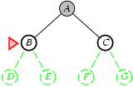
Breadth-first search
Expand shallowest unexpanded node Implementation:
fringe is a FIFO queue, i.e., new successors go at end
*
46

Slide 47
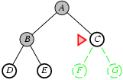
Breadth-first search
Expand shallowest unexpanded node Implementation:
fringe is a FIFO queue, i.e., new successors go at end
*
47

Slide 48
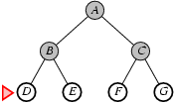
Breadth-first search
Expand shallowest unexpanded node Implementation:
fringe is a FIFO queue, i.e., new successors go at end
*
Swati Mali
48

Slide 49
Breadth-first search
One of the simplest algorithms
Also one of the most important
It forms the basis for MANY graph algorithms
49

Slide 50
BFS: Level-by-level traversal
Given a starting vertex s
Visit all vertices at increasing distance from s
Visit all vertices at distance k from s
Then visit all vertices at distance k+1 from s
Then ….
50

Slide 51
BFS(graph g, vertex s)
unmark all vertices in G
q 🡨 new queue
mark s
enqueue(q, s)
while (not empty(q))
curr 🡨 dequeue(q)
visit curr // e.g., print its data
for each edge <curr, V>
if V is unmarked
mark V
enqueue(q, V)
51

Slide 52
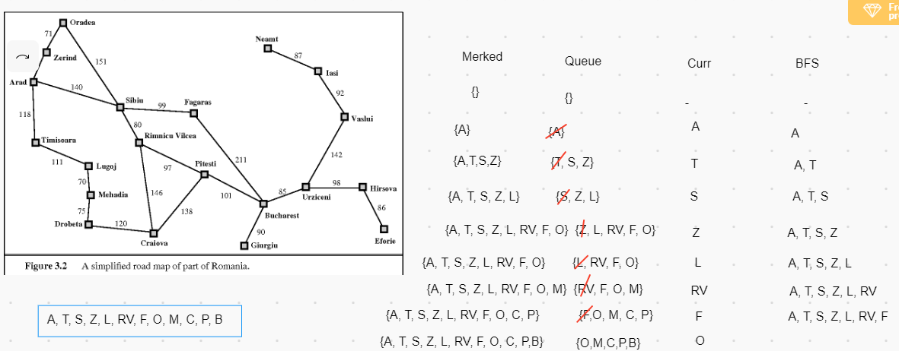
*
Swati Mali
52

Slide 53
Properties of breadth-first search
Complete? Yes (if b is finite) Time? 1+b+b²+b³+… +b^{d} + b(b^{d}-1) = O(b^{d+1}) Space? O(b^{d+1}) (keeps every node in memory) Optimal? Yes (if cost = 1 per step) Space is the bigger problem (more than time)
*
53

Slide 54
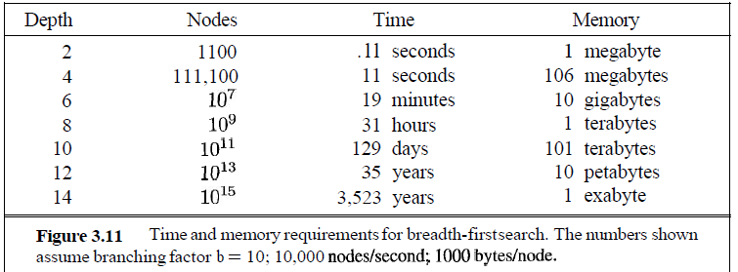
BFS- Time Complexity
*
54

Slide 55
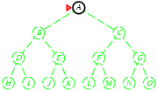
Depth-first search
Expand deepest unexpanded node Implementation:
fringe = LIFO queue, i.e., put successors at front
*
55

Slide 56
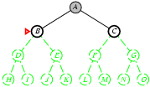
Depth-first search
Expand deepest unexpanded node Implementation:
fringe = LIFO queue, i.e., put successors at front
*
56

Slide 57
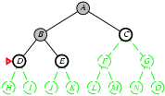
Depth-first search
Expand deepest unexpanded node Implementation:
fringe = LIFO queue, i.e., put successors at front
*
57

Slide 58
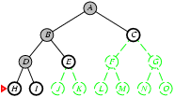
Depth-first search
Expand deepest unexpanded node Implementation:
fringe = LIFO queue, i.e., put successors at front
*
58

Slide 59
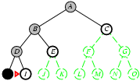
Depth-first search
Expand deepest unexpanded node Implementation:
fringe = LIFO queue, i.e., put successors at front
*
59

Slide 60
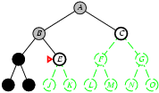
Depth-first search
Expand deepest unexpanded node Implementation:
fringe = LIFO queue, i.e., put successors at front
*
Swati Mali
60

Slide 61
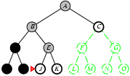
Depth-first search
Expand deepest unexpanded node Implementation:
fringe = LIFO queue, i.e., put successors at front
*
Swati Mali
61

Slide 62
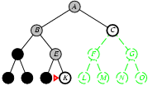
Depth-first search
Expand deepest unexpanded node Implementation:
fringe = LIFO queue, i.e., put successors at front
*
Swati Mali
62

Slide 63
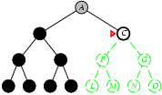
Depth-first search
Expand deepest unexpanded node Implementation:
fringe = LIFO queue, i.e., put successors at front
*
Swati Mali
63

Slide 64
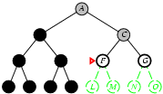
Depth-first search
Expand deepest unexpanded node Implementation:
fringe = LIFO queue, i.e., put successors at front
*
Swati Mali
64

Slide 65
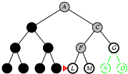
Depth-first search
Expand deepest unexpanded node Implementation:
fringe = LIFO queue, i.e., put successors at front
*
Swati Mali
65

Slide 66
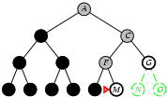
Depth-first search
Expand deepest unexpanded node Implementation:
fringe = LIFO queue, i.e., put successors at front
*
Swati Mali
66

Slide 67
DFS(graph g, vertex s)
unmark all vertices in G
Stack 🡨 new stack
mark s
Push(stack, s)
while (not empty(stack))
curr 🡨 pop(stack)
visit curr // e.g., print its data
for each edge <curr, V>
if V is unmarked
mark V
push(stack, V)
67

Slide 68
Properties of depth-first search
Complete? No: fails in infinite-depth spaces, spaces with loops
Modify to avoid repeated states along path 🡪 complete in finite spaces
Time? O(b^{m}): terrible if m is much larger than d
but if solutions are dense, may be much faster than breadth-first
Space? O(bm), i.e., linear space!
Optimal? No
*
Swati Mali
68

Slide 69
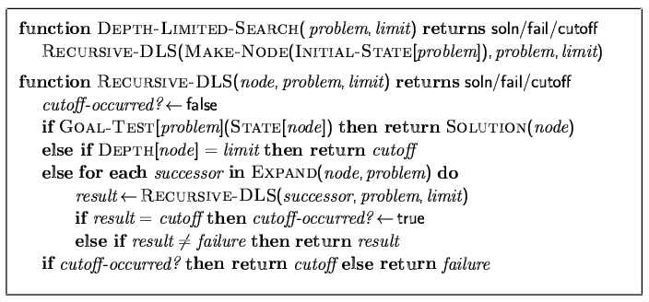
Depth-limited search
Depth-first search with depth limit l,
i.e., nodes at depth l have no successors Recursive implementation:
*
Swati Mali
69

Slide 70
Solutions in DLS
Standard solution
Standard failure
Cut-off failure
*
Swati Mali
70

Slide 71
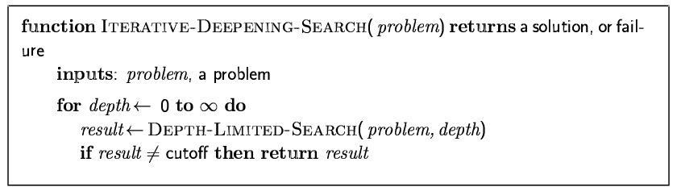
Iterative deepening search
*
Swati Mali
71

Slide 72
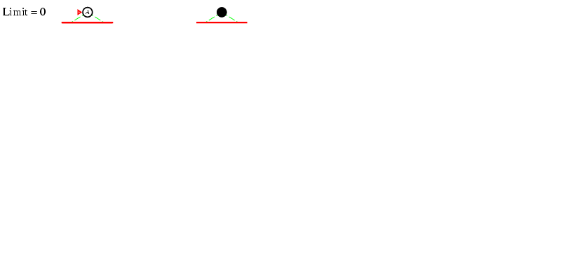
Iterative deepening search l =0
*
Swati Mali
72

Slide 73
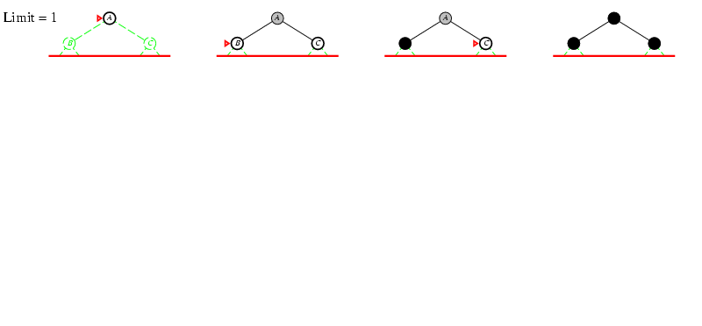
Iterative deepening search l =1
*
Swati Mali
73

Slide 74
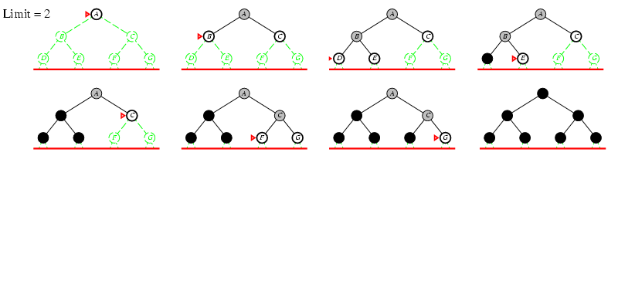
Iterative deepening search l =2
*
Swati Mali
74

Slide 75
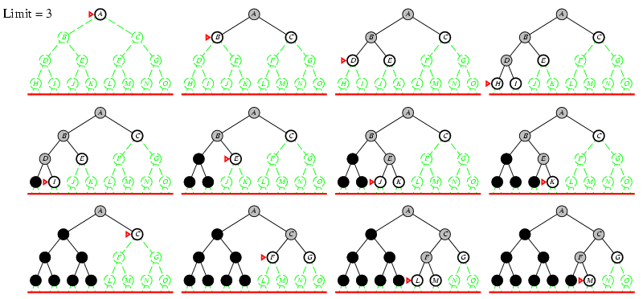
Iterative deepening search l =3
*
Swati Mali
75

Slide 76
Iterative deepening search
Number of nodes generated in a depth-limited search to depth d with branching factor b:
N_{DLS} = b⁰ + b¹ + b² + … + b^{d-2} + b^{d-1} + b^{d}
Number of nodes generated in an iterative deepening search to depth d with branching factor b:
N_{IDS} = (d+1)b⁰ + d b^¹ + (d-1)b^² + … + 3b^{d-2} +2b^{d-1} + 1b^{d}
For b = 10, d = 5,
N_{DLS} = 1 + 10 + 100 + 1,000 + 10,000 + 100,000 = 111,111
N_{BFS}= 10 + 100 + 1000 + 10,000 + 1,00,000 + 999,990 = 1,11,110
N_{IDS} = 6 + 50 + 400 + 3,000 + 20,000 + 100,000 = 123,456
Overhead = (123,456 - 111,111)/111,111 = 11%
*
Swati Mali
76

Slide 77
Properties of iterative deepening search
Complete? Yes Time? (d+1)b⁰ + d b¹ + (d-1)b² + … + b^{d} = O(b^{d}) Space? O(bd) Optimal? Yes, if step cost = 1
*
Swati Mali
77

Slide 78
Uniform-cost search
Expand least-cost unexpanded node Implementation:
fringe = queue ordered by path cost
Equivalent to breadth-first if step costs all equal
Complete? Yes, if step cost ≥ ε Time? # of nodes with g ≤ cost of optimal solution, O(b^{ceiling(C*/ ε)}) where C* is the cost of the optimal solution
Space? # of nodes with g ≤ cost of optimal solution, O(b^{ceiling(C*/ ε)}) Optimal? Yes – nodes expanded in increasing order of g(n)
*
Swati Mali
78

Slide 79
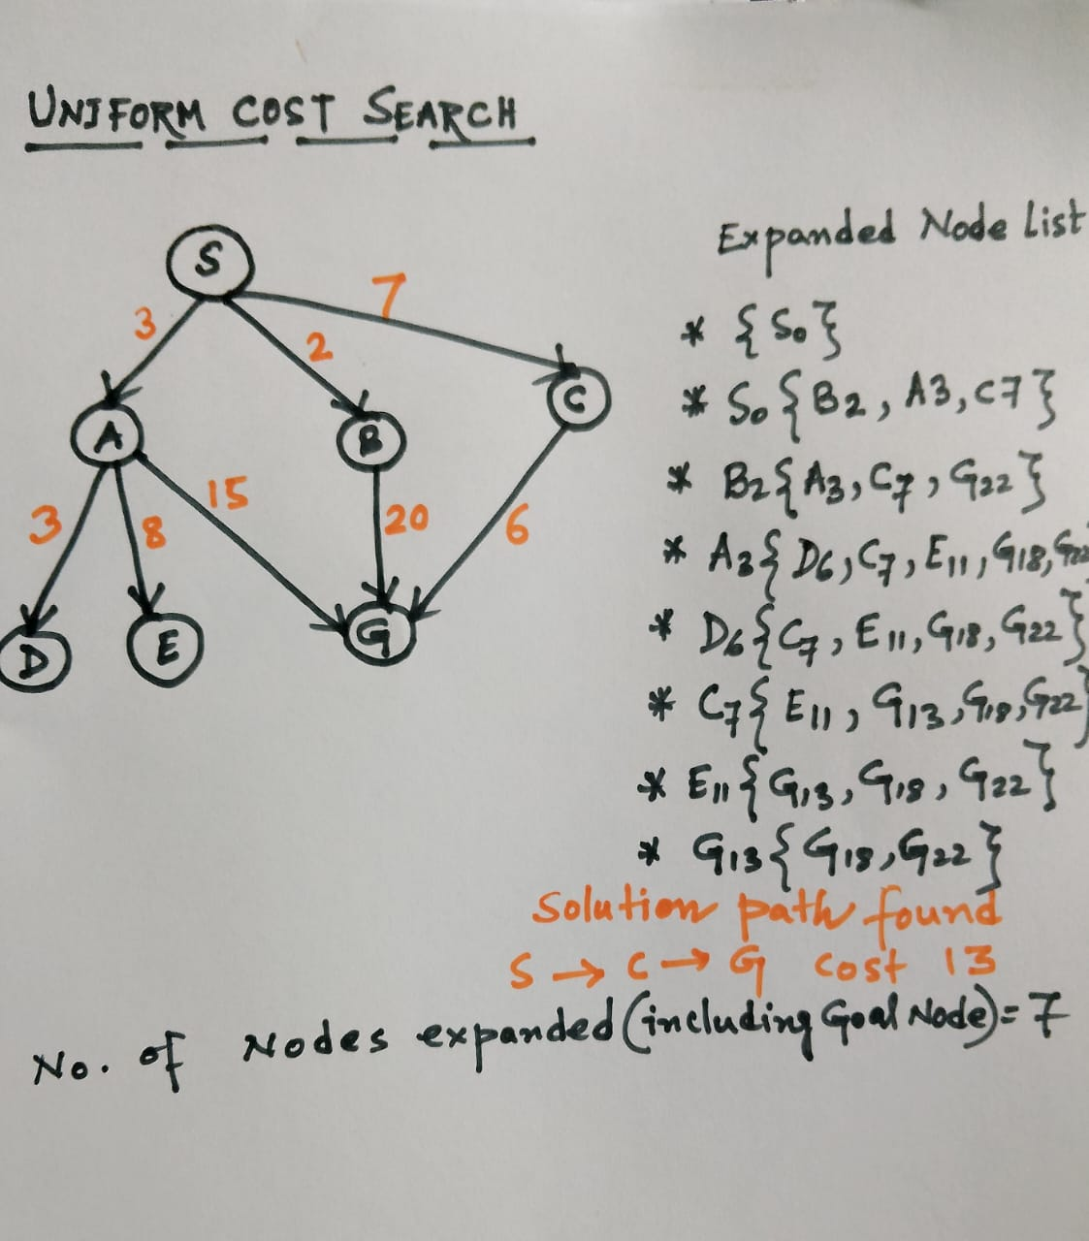

Slide 80
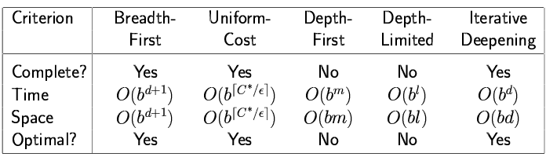
Summary of algorithms
*
Swati Mali
80

Slide 81
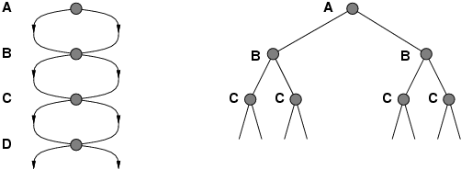
Repeated states
Failure to detect repeated states can turn a linear problem into an exponential one!
*
Swati Mali
81

Slide 82
Map of Romania problem
Formulate the problem.
Draw the state space tree for the given initial state and goal state configuration.
Run BFS, DFS and IDS on the tree to reach goal and write sequence nodes visited for each algorithm
*
Swati Mali
82

Slide 83
Romania-Run BFS, DFS, DLS,IDS
*
Swati Mali
83

Slide 84
8-puzzle problem
Formulate the 8-puzzle problem.
Draw the state space tree for the given initial state and goal state configuration.
Run BFS, DFS and IDS on the tree to reach goal and write sequence nodes visited for each algorithm
*
Swati Mali
84

Slide 85
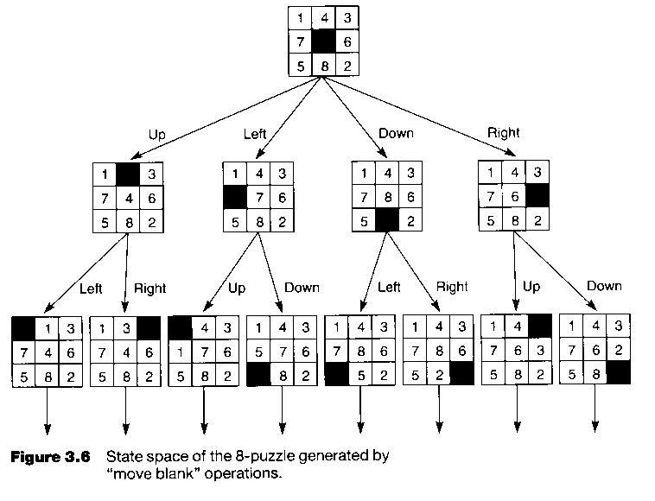

Slide 86
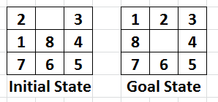
8-Puzzle BFS, DFS, DLS, IDS
*
Swati Mali
86

Slide 87
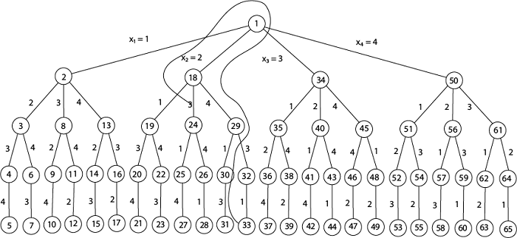

Slide 88
Water jug problem
Consider two water jugs - 3 liters and 5 liters capacity, without any marking on them. The problem is to get exactly 4 liters of water in 5 liter jug; amount of water contained in 3 liter jug doesn’t matter.
Give problem formulation for the stated problem.
Draw entire state space tree for water jug problem.
Run BFS, DFS and IDS on the tree to reach goal and write sequence nodes visited for each algorithm.
*
Swati Mali
88

Slide 89
Blind -> informed
Roman Holiday
Eight Puzzle
N Queens
Chess
Flat Tire Problem
*
Swati Mali
89

Slide 90
Summary
Problem formulation usually requires abstracting away real-world details to define a state space that can feasibly be explored Variety of uninformed search strategies Iterative deepening search uses only linear space and not much more time than other uninformed algorithms
*
Swati Mali
90

